Slide 1
Copenhagen Hackathon
Mia Mayer
Young Lee
5th June 2018

Slide 2
Vision
”Auto-generation of push notification for travelers and locals for a better and more customized experience for tourists”

Slide 3
Our Solution
Framing the problem
Push Notification Recommendation | Send by popularity?
Tivoli Aquarium | Yes
Bianca D'Alessandro | Yes
City Hall Square | No
History & Art | No
Ny Carlsberg Glyptotek | Yes
Does it relate to making
Better and more customized experience for tourists???
Not really…

Slide 4
Our Solution
Framing the problem
Push Notification Recommendation | Send by TripAdvisor review scores?
Tivoli Aquarium | Yes
Bianca D'Alessandro | Yes
City Hall Square | No
History & Art | No
Ny Carlsberg Glyptotek | Yes
Does it relate to making
Better and more customized experience for tourists???
Better…

Slide 5
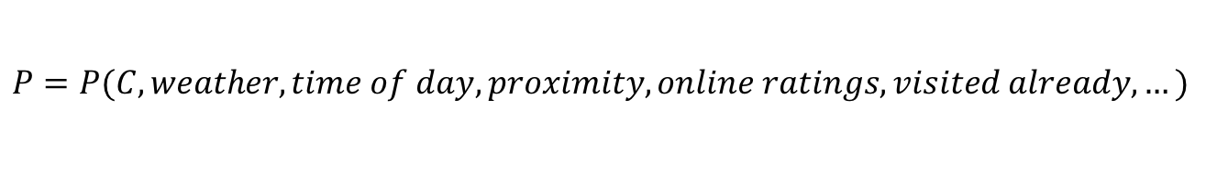
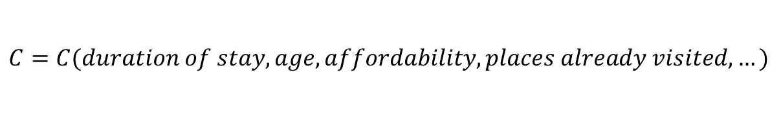
Our Solution
Framing the problem
Push notification scores tailored to customer
Push Notification Recommendation | Predicted Satisfaction Score
Tivoli Aquarium | 4.8
Bianca D'Alessandro | 3.5
City Hall Square | 1.1
History & Art | 0.3
Ny Carlsberg Glyptotek | 1.2
Does it relate to making
Better and more customized experience for tourists???
Best Option
We built 2 machine learning models:
$$C=C(duration of stay, age, affordability, places already visited, …)$$
$$P=P(C, weather, time of day, proximity, online ratings, visited already, …)$$

Slide 6
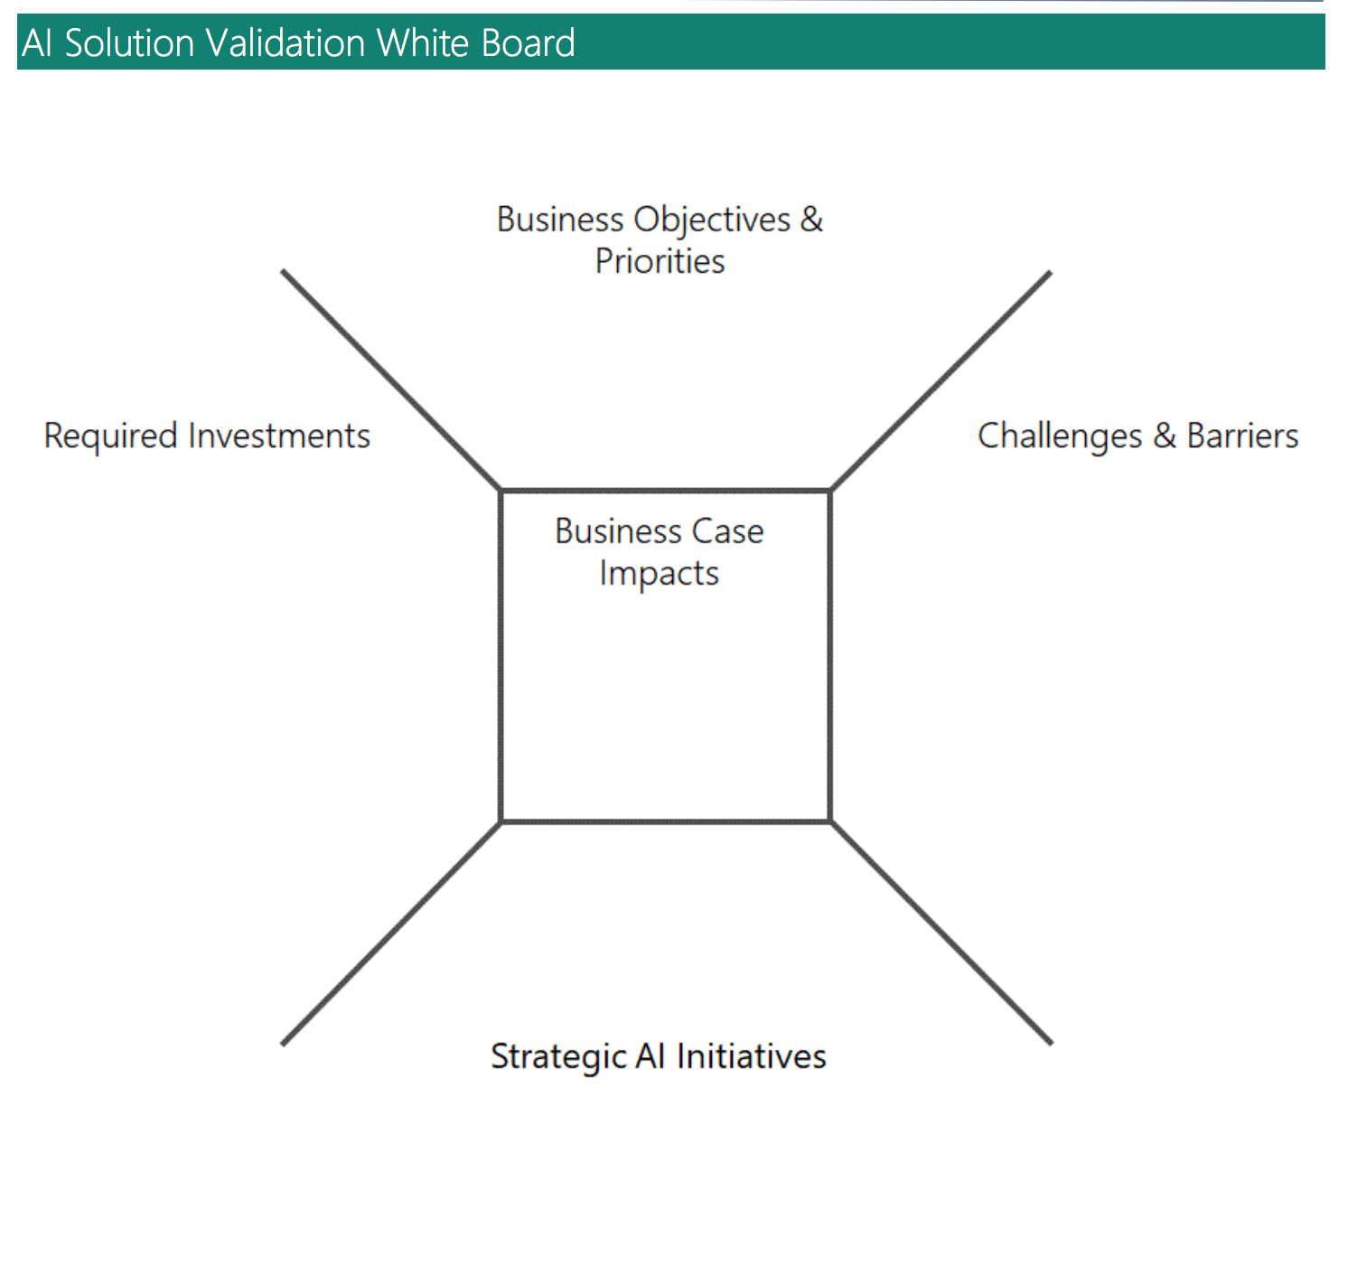
Family Holiday
Looking for a pleasant time
Planning ahead
Satisfy children
Couples
Businessman/woman
Actively searching for romantic places
Love couple activities
Want a chance to escape?
Busy – pressed for time
Don’t bother me during working hours
Seek key & major tour
Who are our customers?
What are they looking for?
What can we offer?
Locals
Let me know what’s happening real time to avoid traffic

Slide 7
Temporal activity
Venue crowdedness forecast
Social media trends (NLP)
Google ratings
Deep neural network
Collected Data
Feature Engineering
Segmentation
Predict Satisfaction Levels
Live Twitter Streaming
Google Places
Clustering groups of similar customer by behaviour
TripAdvisor
Geospatial shapefiles
Notes:
Social media feed
Weather
Crowdedness
Venues open
Current location
Customer segment
Affordability
Preferences

Slide 8
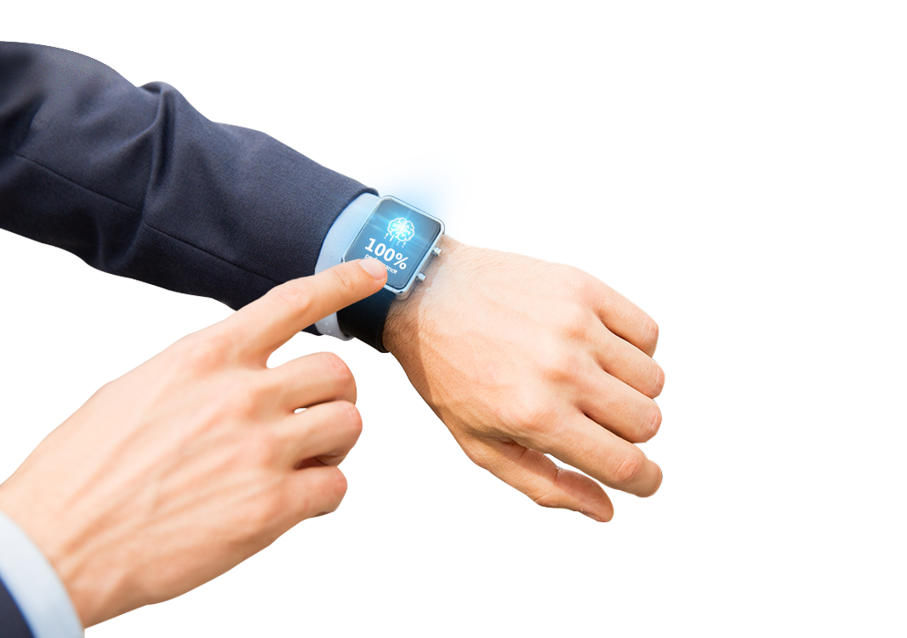

Demo!
Presentation Title | Author | Date
Notes:
A forma SEMPRE tem que ter ponta!

Slide 9


Results
Powered by AI
Scalable solution
Near-time (<1sec run time)
Respecting privacy and security

Slide 10

Future
Data enrichment through questionnaires
01
Better predictive accuracy of model
02
Better segmentation
03
2nd order prediction of satisfaction levels
04
Chatbot
05
Real-time
06

